Slide 1
Types of Government

Slide 2
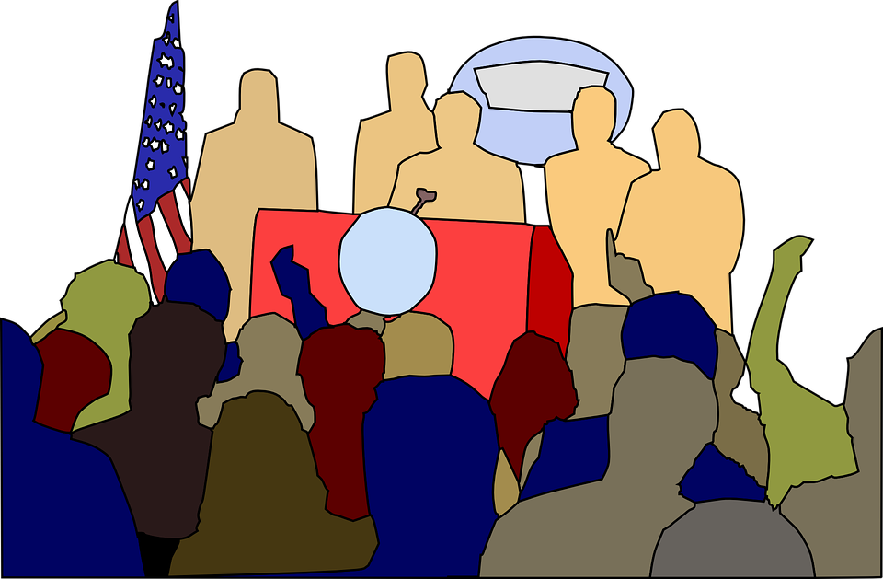
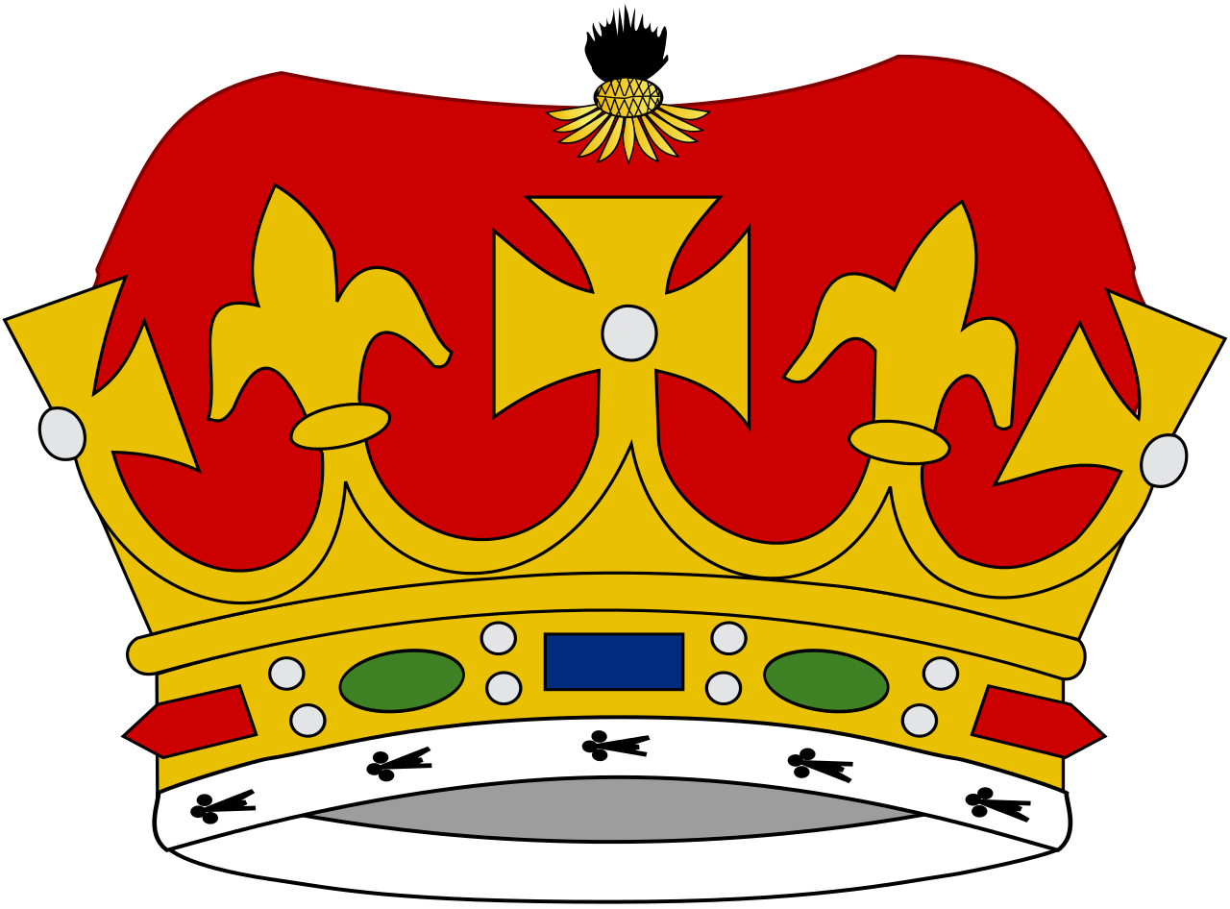
What is Government?
The institution through which a society makes and enforces its public policies

Slide 3
Ok, So What Does That Mean?
That means a country sets up rules and procedures that certain people believe will be the best for the country.
Questions you need to ask when looking at government:
Who has the power in the government?
What type of laws are created for the country?
Does the government protect the citizens of the country?

Slide 4
The Different Types of Government
These are the different types of government we see today:
Monarchy
Dictatorship
Republic
Direct Democracy
Oligarchy
Theocracy

Slide 5
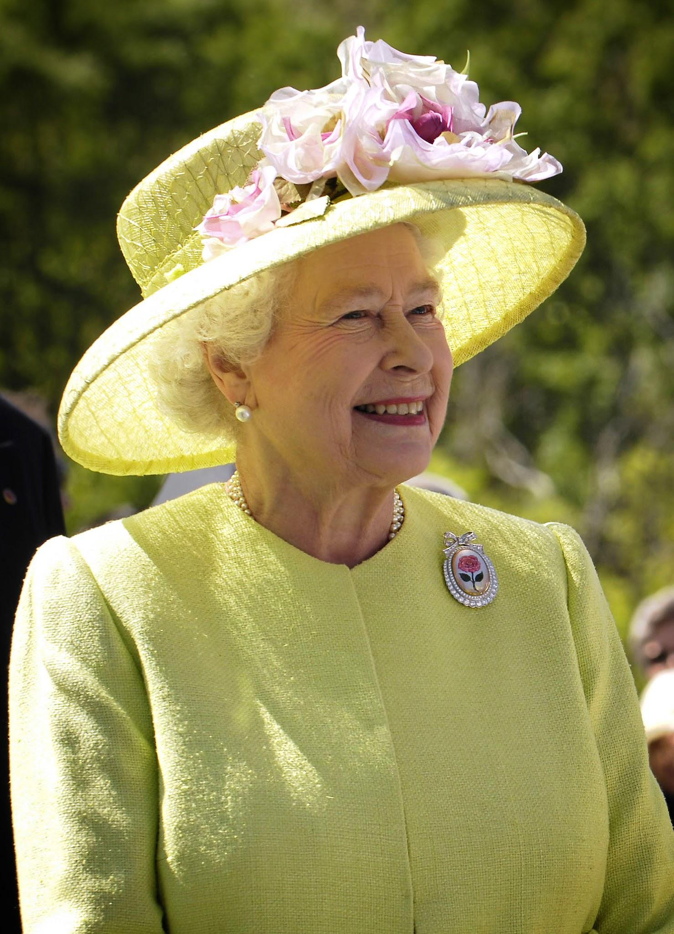
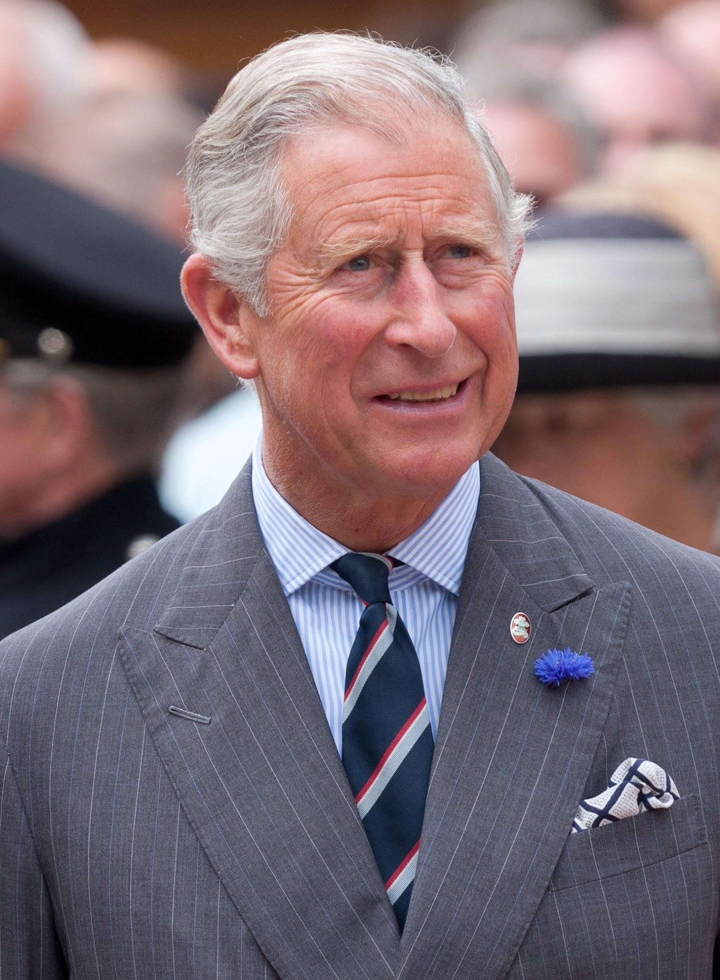
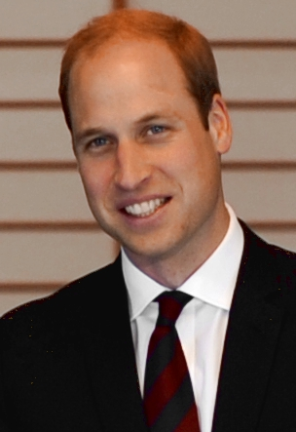
What is a Monarchy?
A monarchy is where one person, a king or queen, rules over the country
Monarchies are known to be an Autocracy
This means one person in power
The power is passed down through the family

Slide 6
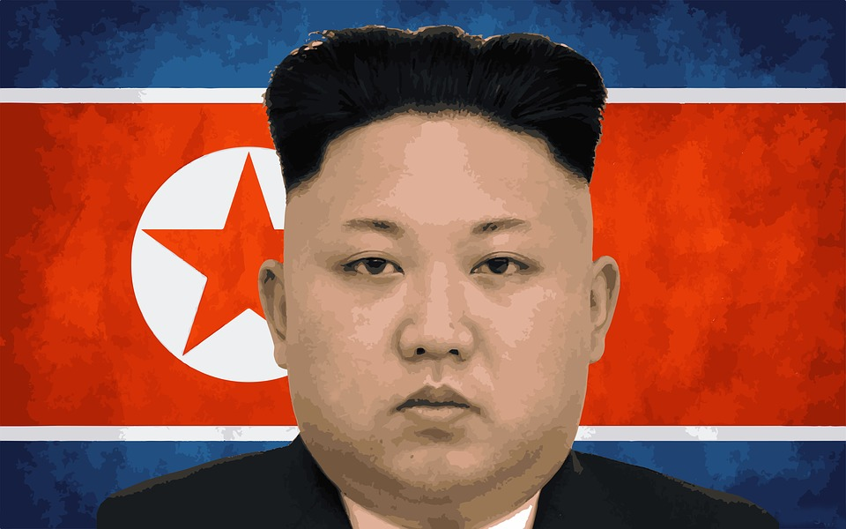
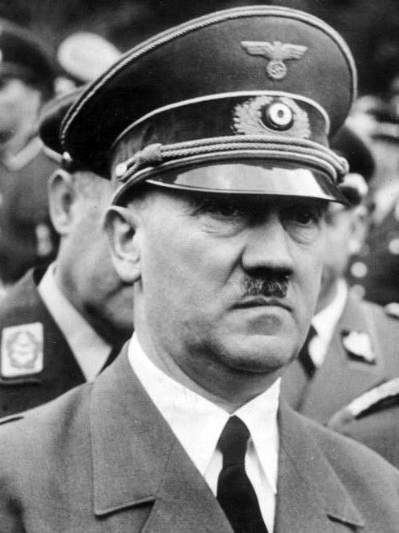
What is a Dictatorship?
A dictatorship is where one person has complete control over everything in the government
Dictatorships are also known as autocracies
Most also fall into the category of Totalitarianism
This means they control all aspects of citizens’ lives
Kim Jong Un, North Korea
Adolf Hitler, Germany

Slide 7
Power to the People!!
Democracies are the most common form of government we see today
Democracies give the power to the citizens of the country to make decisions about the country
There are two different types of democracies
Republic
Direct Democracies

Slide 8
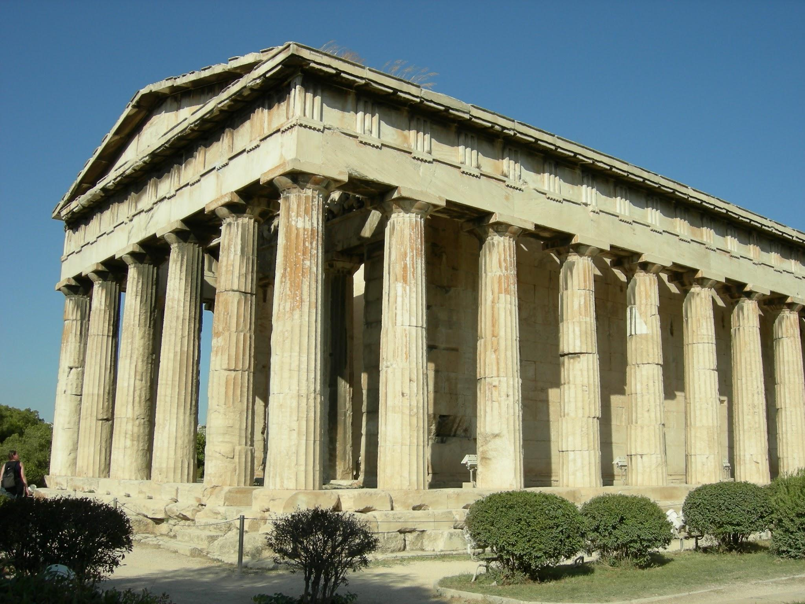
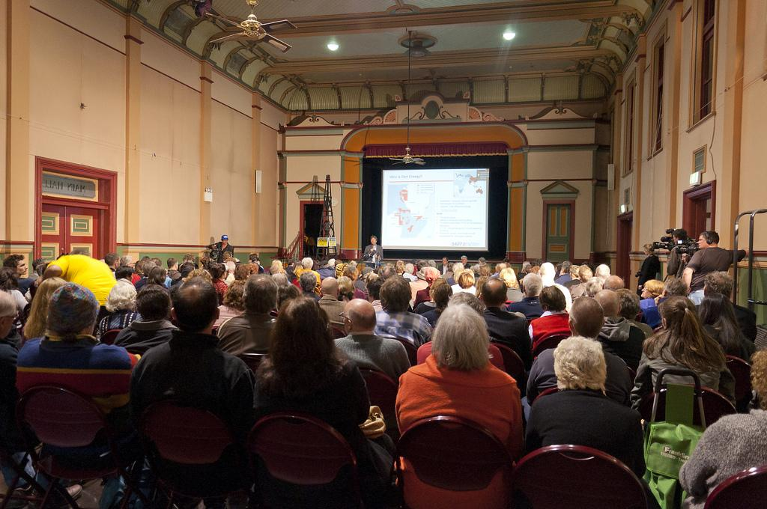
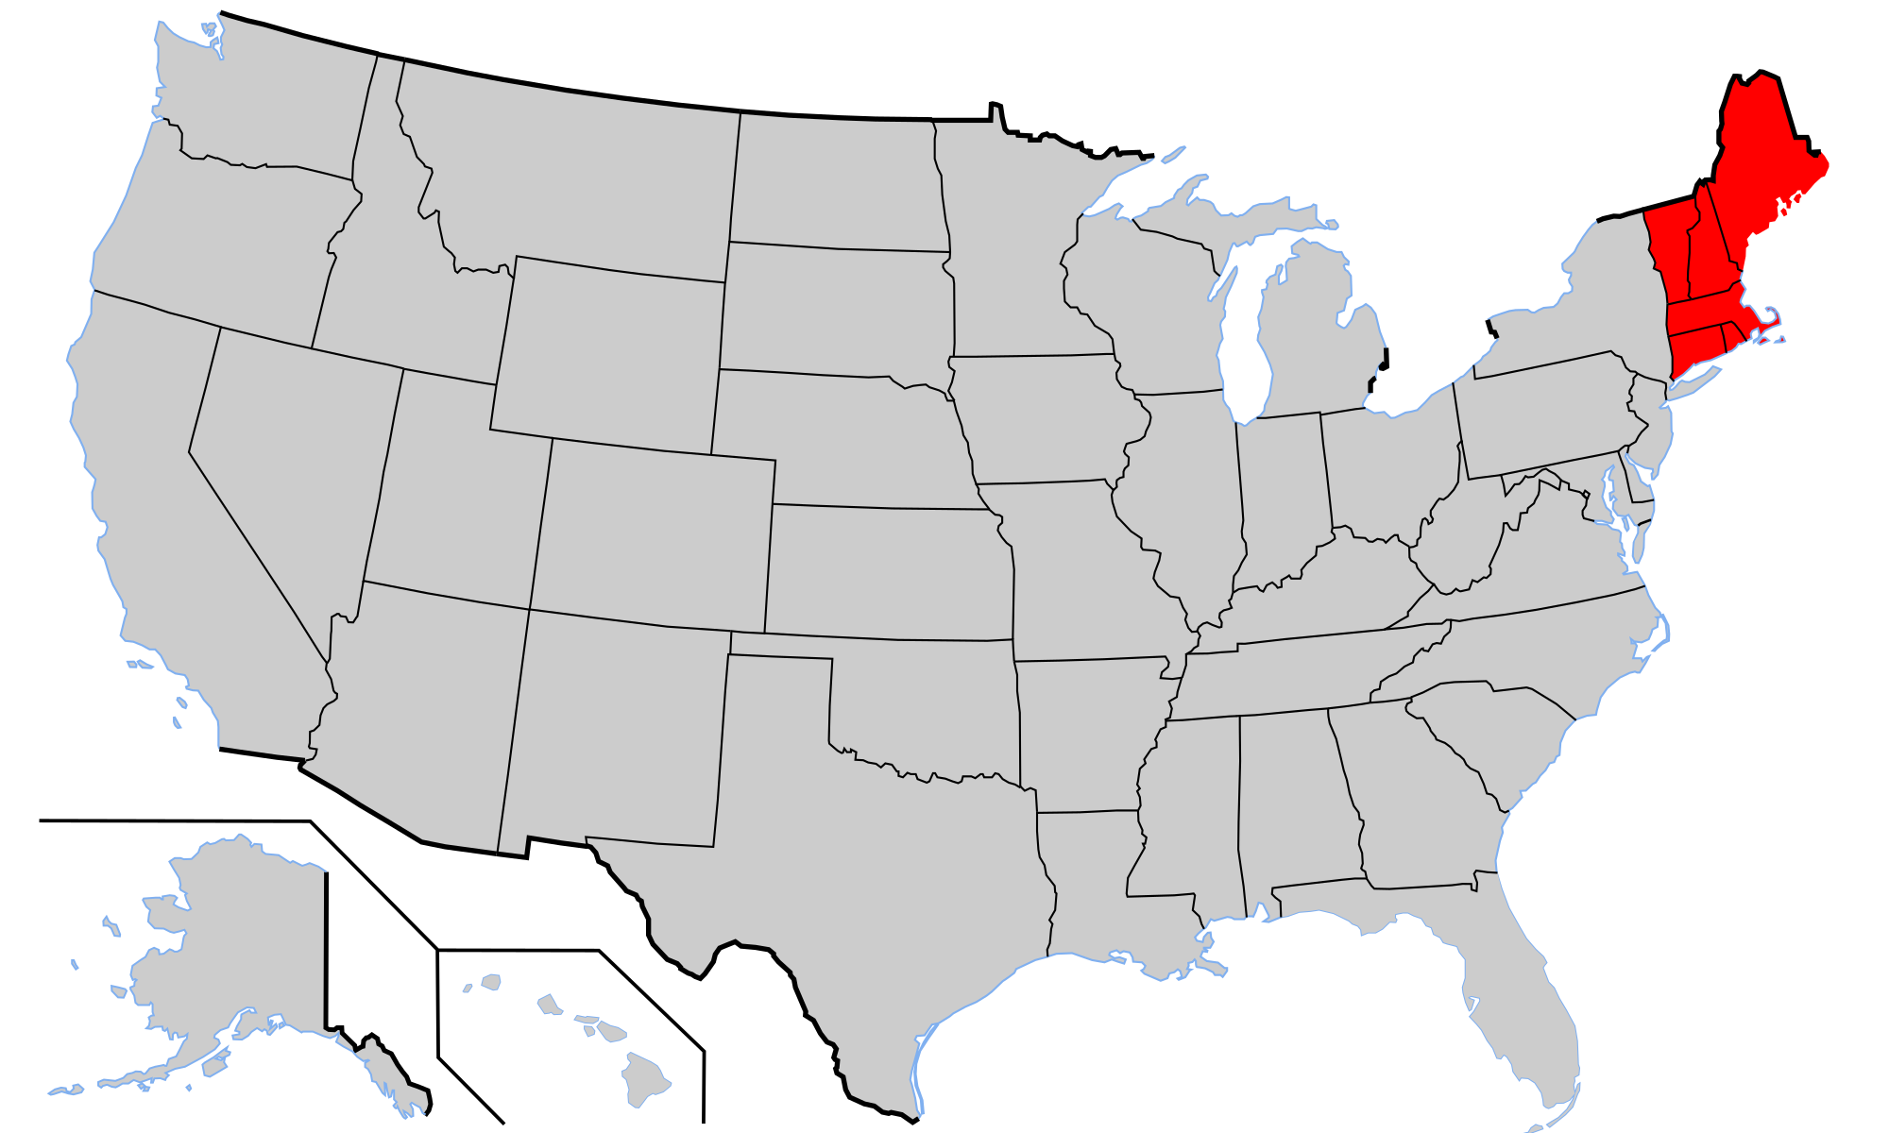
What is a Direct Democracy?
A direct democracy is where citizens take full participation into the decisions of the country
This means every citizen votes on every law or issue, they are judges in cases, and are involved in the day-to-day work of the government
Ancient Greece is where we saw the first direct democracy
New England town hall meeting is an example today

Slide 9
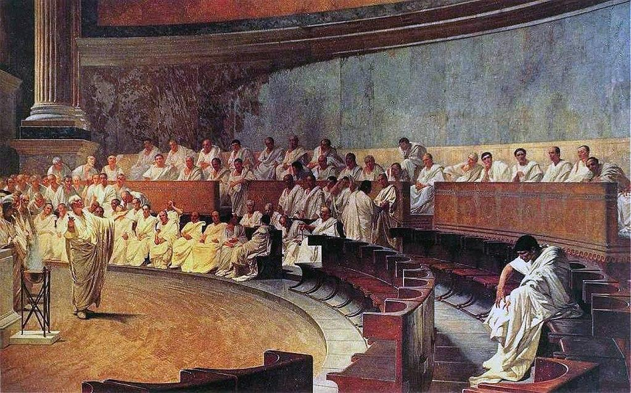
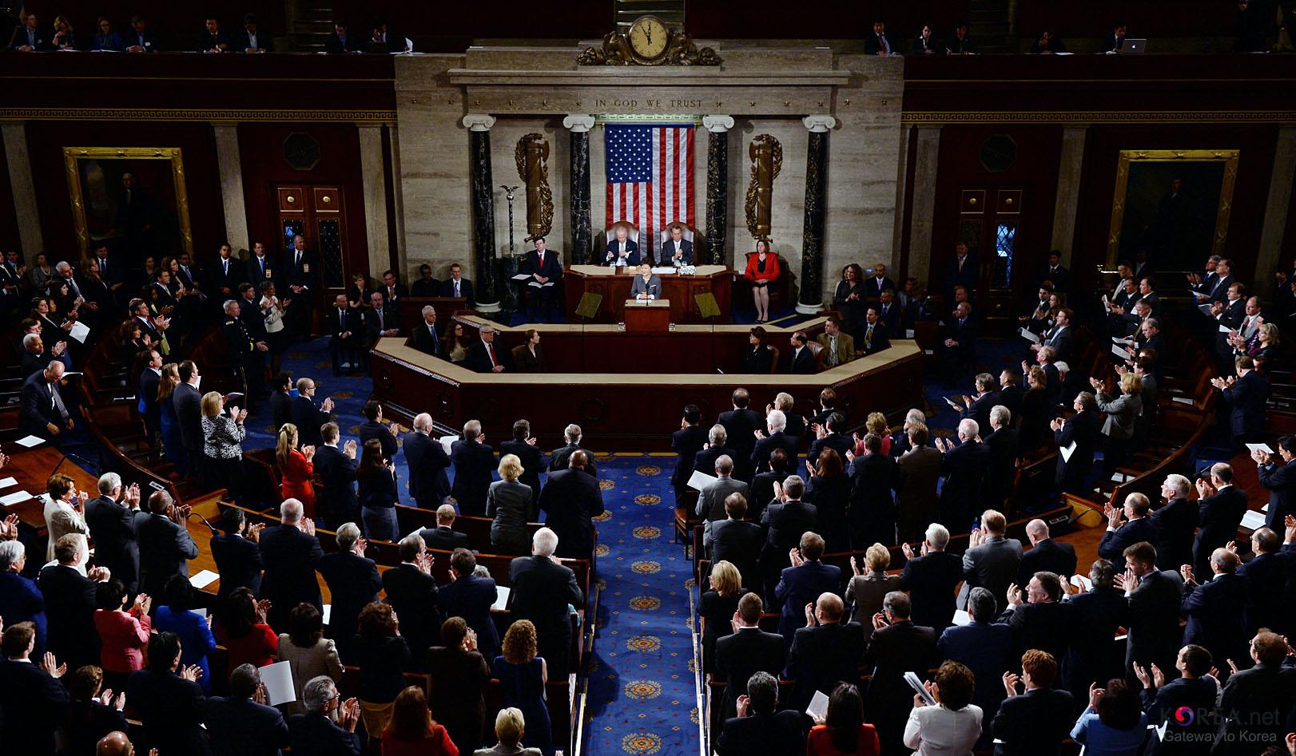
What is a Republic?
A republic is where citizens elect people to represent them in the government
Ancient Rome is where the first republic was created
The United States is also an example of a republic
We vote in state elections and national elections to have people represent us in the government

Slide 10
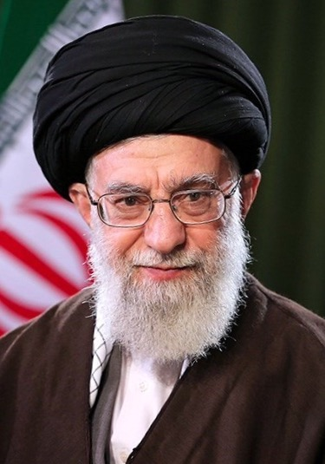
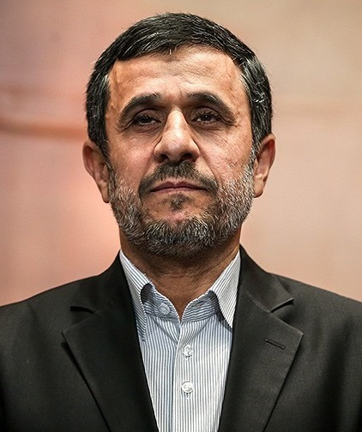
What is a Theocracy?
A theocracy is government ruled by or subject to religious authority.
Theocracies can also fall into different types of governments like democracies, dictatorships, and oligarchies.
Theocracy just means that the country uses religious law to form the government or have religious leaders in power
An example of a Theocracy is Iran
Hassan Rouhani, Religious Leader of Iran
Mahmoud Ahmadinejad, Political Leader of Iran

Slide 11
What is an Oligarchy?
An oligarchy is government ruled by a few powerful people
Juntas are an example of an oligarchy
The military taking over power in a country means the group of leaders take power
An example of a Junta is the Country Libya
An example of an oligarchy is Saudi Arabia

