Slide 1
Elements of a Map
DOGSTAILS

Slide 2
What makes a good map?
Cartographers, people who make maps, have to follow certain rules when they are making maps.
In order to have a map that people can rely on, the cartographer must have certain elements on the map
There is a simple acronym that we use to remember what these elements are
DOGSTAILS

Slide 3
What does DOGSTAILS stand for?
Date Title
Orientation Author
Grid Index
Scale Legend
Situation

Slide 4
Date
When was the map made?
Is it still reliable?
Many things can change with the world, so keeping maps up to date is important.

Slide 5
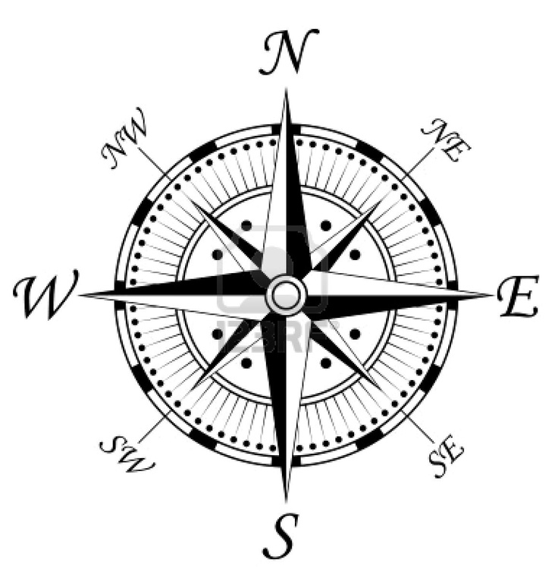
Orientation
What are the principal directions shown, and how are they shown?

Slide 6
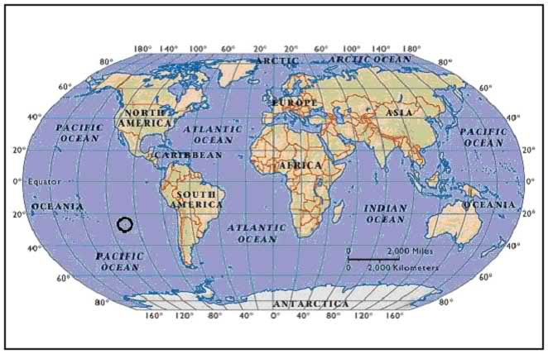
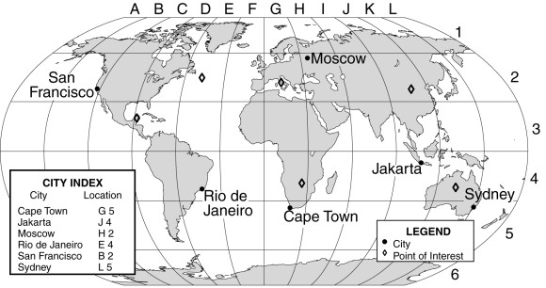
Grid
What kind of grid system is used? (Latitude/Longitude or Coordinates?)

Slide 7
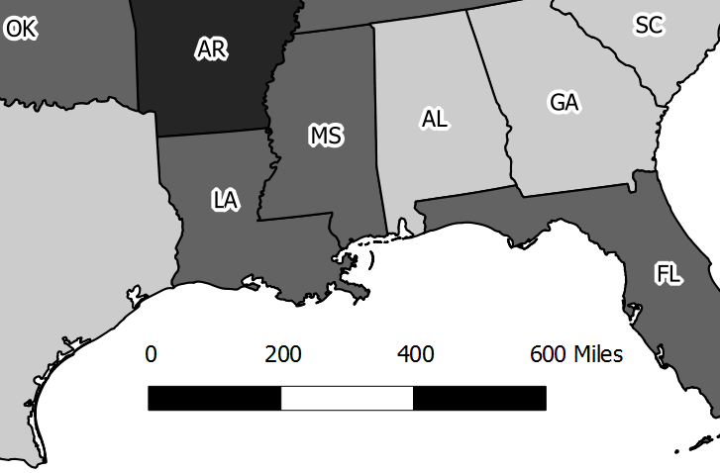
Scale
Is there a map scale?
Uses a ratio to make the map a scaled down version of the real thing

Slide 8
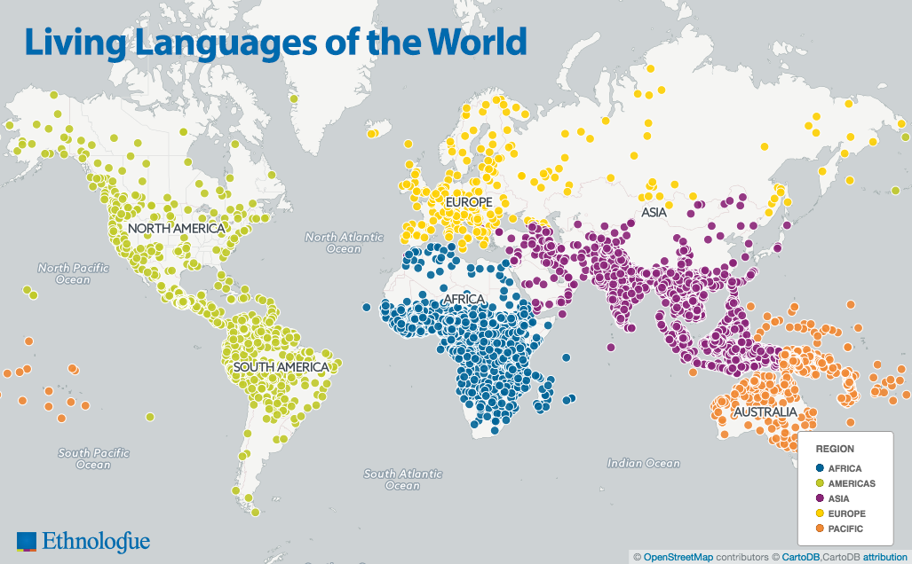
Title
What is the title of the map?
What is the time and place of the map?

Slide 9
Author
Who made the map?

Slide 10
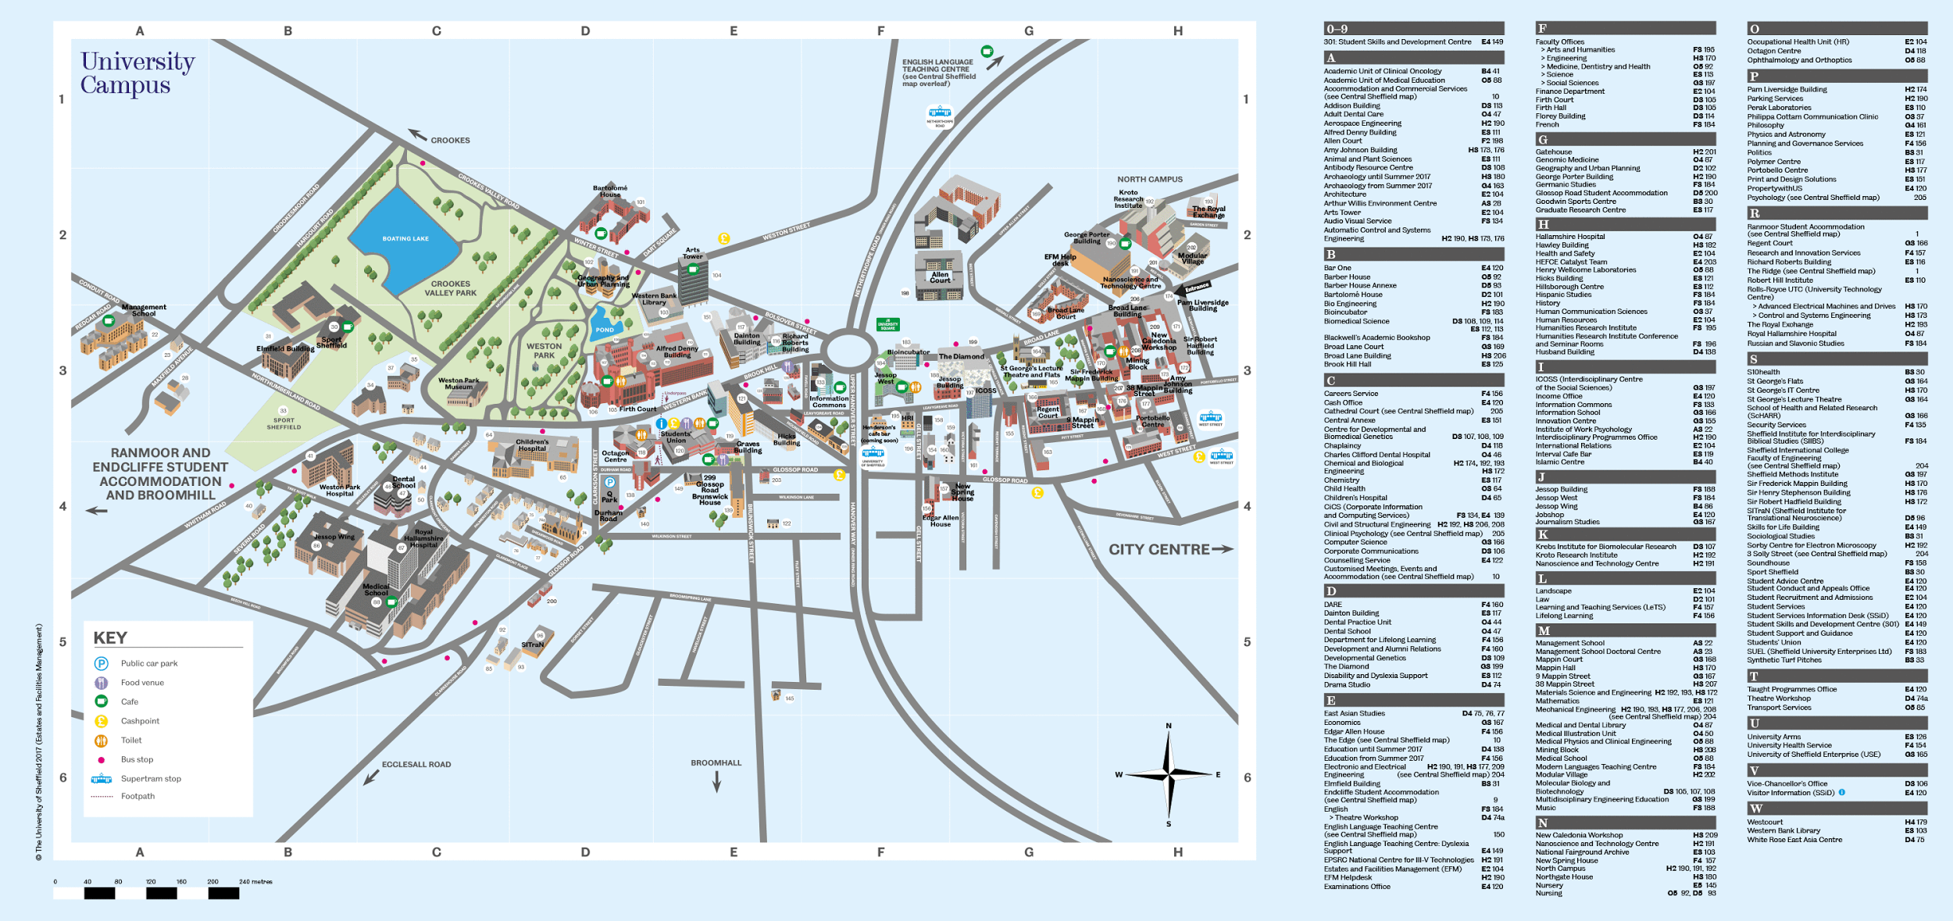
Index
Does the map have an alphabetical listing of places and a grid?

Slide 11
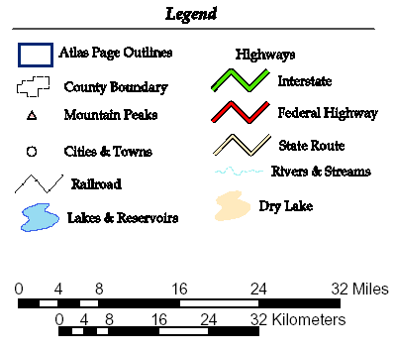
Legend
Also known as a key
Does the map have a legend that explains the map symbols?

Slide 12
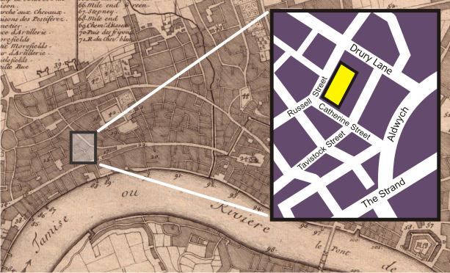
Situation
Does the map show this location in relation to other places, such as an inset map?
Inset map is a zoomed in map of a bigger map

Slide 13
Now Let’s Practice
We are going to practice to see what map elements certain maps all have and some do not.

Slide 14
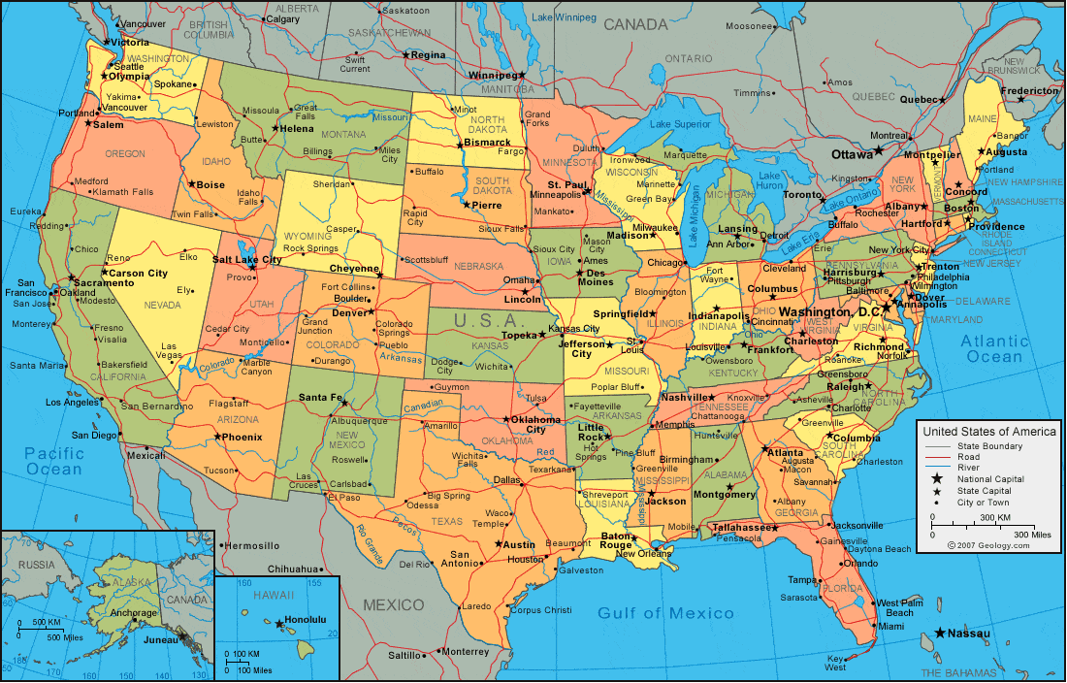

Slide 15
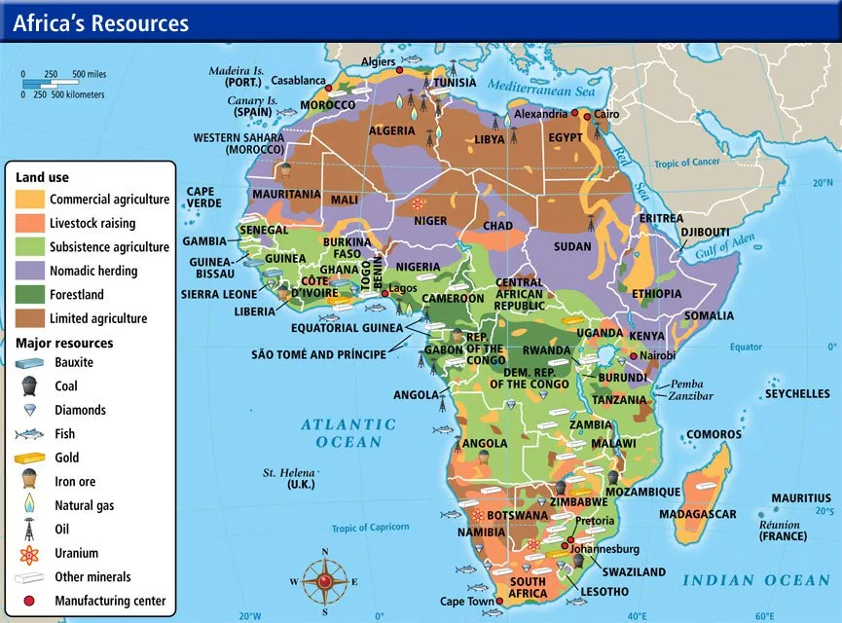

Slide 16
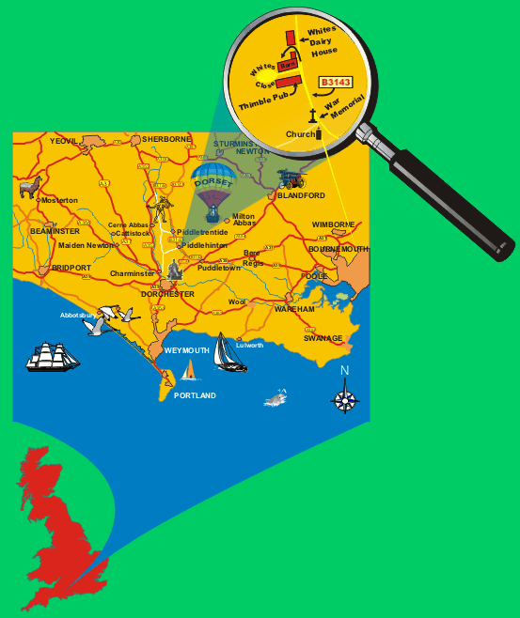

Slide 17
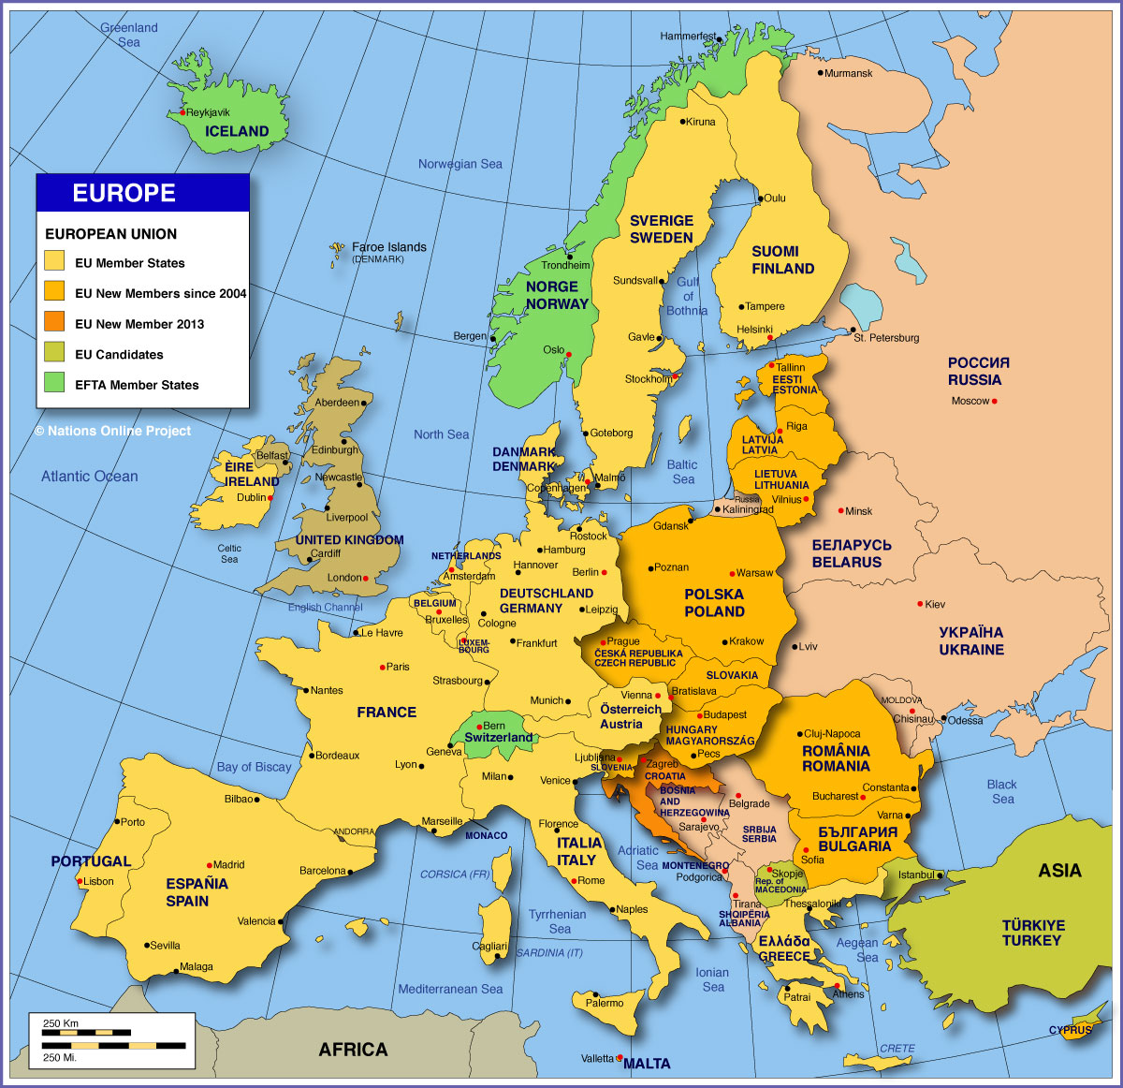

Slide 18
