Slide 1
Culture
The Elements of Culture

Slide 2
What is Culture?
Culture is a set of beliefs, values, and practices that a group of people have in common.
C- clothing
R- religion
A- art
F- food
T- traditions
Go- government/economics
L- language
D- daily life

Slide 3
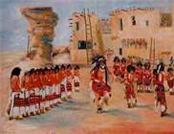
Culture
Culture Trait is an activity or behavior in which people often take part.
Examples
In the United States: Football
In Germany: They speak German
In India: Major Religion is Hinduism

Slide 4
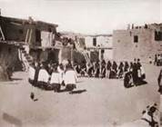
Culture
Culture Region is an area in which people have many shared cultural traits
Examples
The Middle East
The Amish lifestyle in Pennsylvania
Chinatown in San Francisco

Slide 5
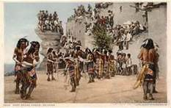
Culture
Ethnic Group is a group of people who share a common culture and ancestry.
Examples
Dutch
Germans
English

Slide 6
Culture
Culture Diversity is the state of having a variety of cultures in the same area
Examples
New York City
Los Angeles
Bowling Green

Slide 7
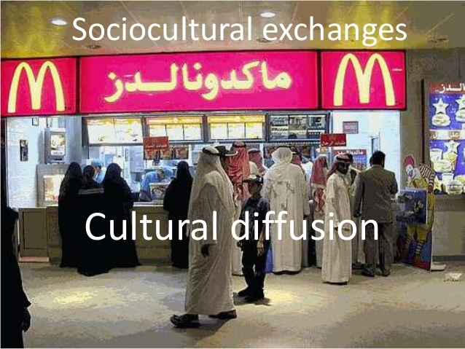
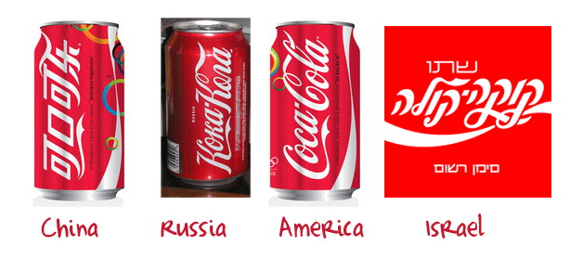
Culture
Culture Diffusion is the spread of culture traits from one region to another.

Slide 8
Culture
Why is it important to learn about culture?
The world includes many different culture groups.
New ideas and events lead to changes in culture.

Slide 9
Culture
The Big Idea:
Culture, a group’s shared practices and beliefs, differs from group to group and changes over time.

Slide 10
Questions To Think About
What causes it to change over time?
How might the world be different if we all shared the same culture?

Slide 11
Exit Slip
What is culture?
Name one element of culture.
The spread of cultural traits is known as…
An area where people share many cultural traits is known as…
Why might cultural diversity cause conflict?

