Slide 1
Continents, Oceans, Latitude, and Longitude

Slide 2
The Continents and Oceans
On the first page of your packet, label the map with the ocean and continents.
Time to complete: 10 minutes

Slide 3
Cardinal Directions
The cardinal directions are what we use to determine the direction in which we are going.
It uses the North Pole as the reference point.
Compass is the tool used with the cardinal directions

Slide 4
Latitude and Longitude
To figure out exactly where we are in the world, we also use Latitude and Longitude
When using Latitude and Longitude, it creates coordinates for people to locate you.
For example, telling someone you’re coordinates are 60 degrees North 80 degrees West
When saying latitude and longitude, you always start with latitude first, then longitude
We also use degrees when giving out latitude and longitude

Slide 5
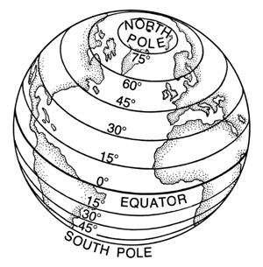
Latitude
Lines used for location that measure North and South directions.
Latitude lines are also known as parallels because they never touch

Slide 6
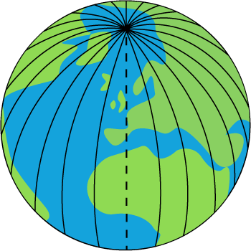
Longitude
Lines used for location that measure East and West directions.
Longitude lines are also known as meridians
These lines meet together and both the North and South Poles

Slide 7
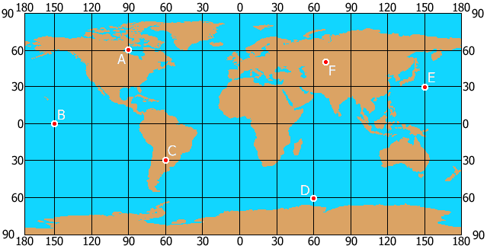
Latitude and Longitude
Combining Latitude and Longitude on a map or globe gives us a grid to use to locate people
This is where coordinates come into play

Slide 8
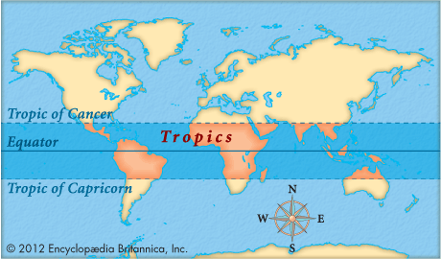
Important Lines to Remember
The Tropics
Tropic of Cancer
23 ½ degrees North Latitude
Tropic of Capricorn
23 ½ degrees South Latitude

Slide 9
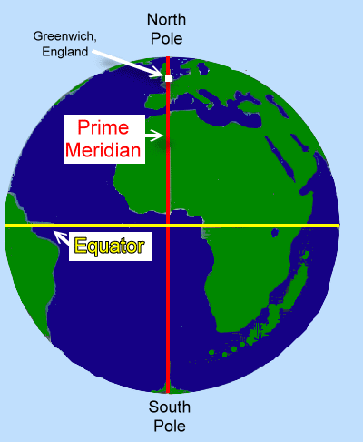
Important Lines to Remember
Equator
Splits the Earth into the Northern and Southern Hemispheres
Prime Meridian
Splits the Earth into the Eastern and Western Hemispheres

Slide 10
Important Lines to Remember
Along with the Primes Meridian you have the International Dateline
This is at 180 degrees Longitude
We use these two lines not only to determine longitude, but also time
The International Dateline is where our days officially begin!

Slide 11
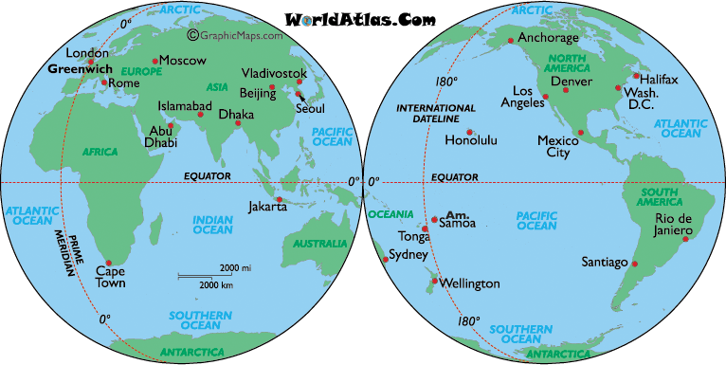

Slide 12
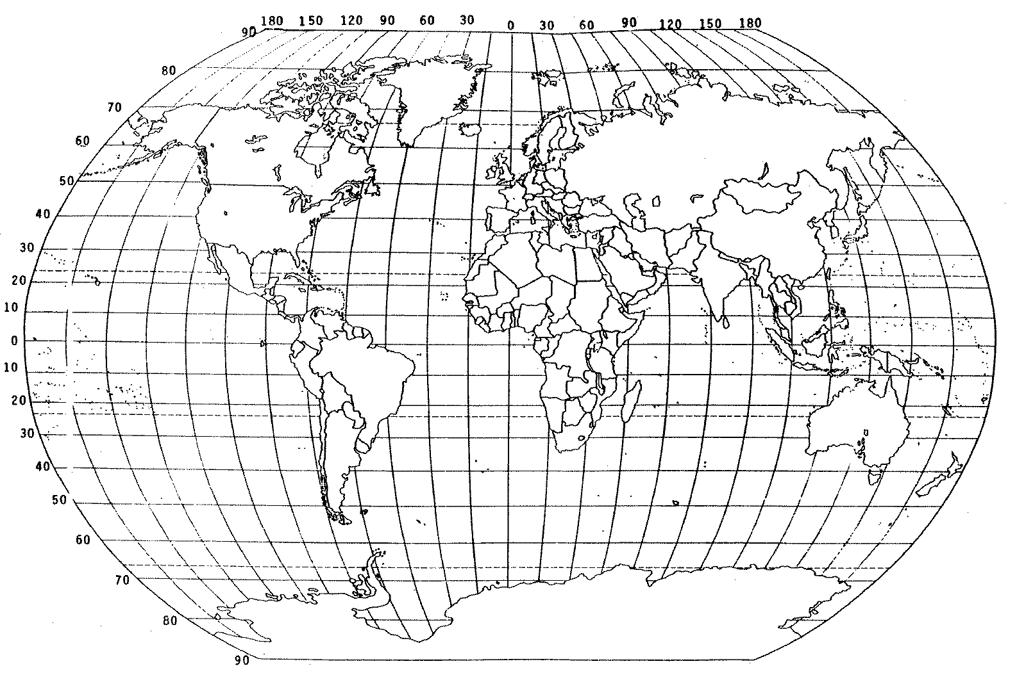

Slide 13
Latitude and Longitude Practice
Now that we have labeled our map, let's practice using latitude and longitude!

