Slide 1
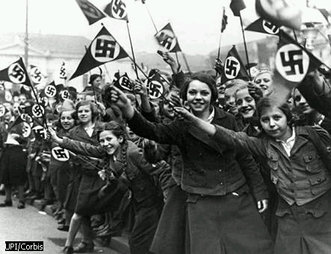
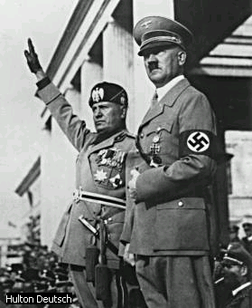
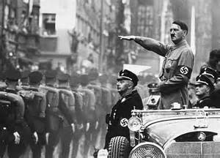
The Rise of Nazism
World War I’s Effect on Germany

Slide 2
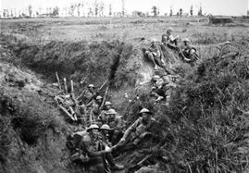
WWI’s Effect on Germany
Germany had many problems after WWI:
Lost lands that contained valuable natural resources,
2 ½ million Germans died,
4 million were wounded,
Industry (factories) & farms in the country had been destroyed, and
Highways, bridges, & roads were demolished.

Slide 3
Solving Germany’s Problems
Government worked to fix these things, but a major obstacle stood in the way…
Treaty of Versailles:
Germany had to pay reparations to the Allied countries for war damages
Millions of dollars were leaving the country for France & Great Britain
Also, because Germany was forbidden to have a large army or navy, many military people lost their jobs

Slide 4
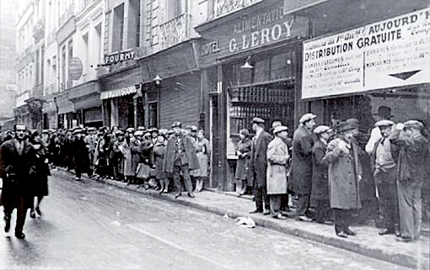
Unemployment Line

Slide 5
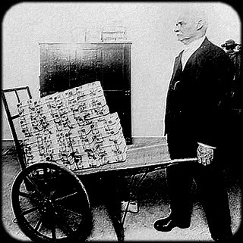
Germany’s Economic Depression
Prices went up as goods became scarce.
Basic items such as food and clothing were not always available.
Men had trouble finding jobs to support their families.
The value of German money suffered from inflation…

Slide 6
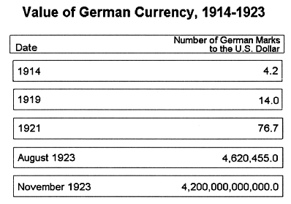
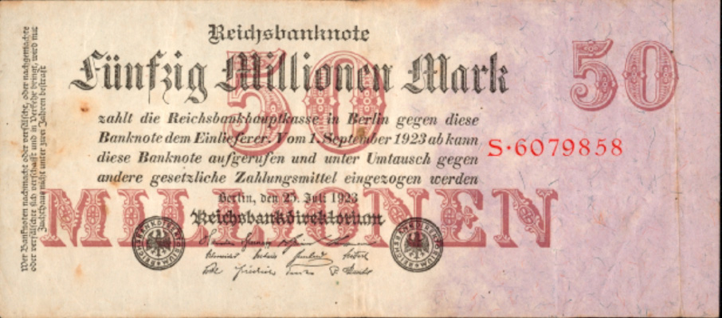

Slide 7
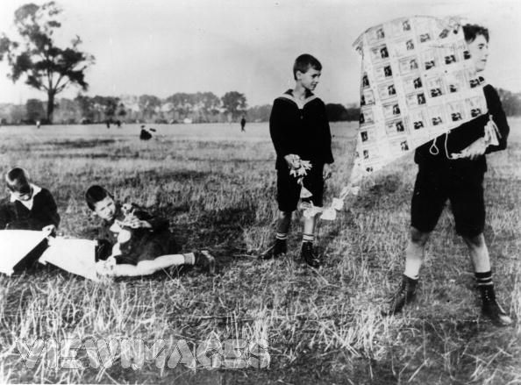
The deutschmark in 1923 was only good for making kites…

Slide 8
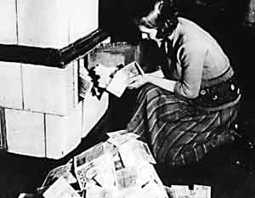

Slide 9
Adolf Hitler
As things got worse, people blamed the government…
Adolf Hitler came on the scene with a promise to fix Germany’s problems.
He blamed the Treaty of Versailles for many of the problems.
He also said that Jews were controlling German banks & money.
He blamed Jews for the fact that Germans were not able to make a good living.

Slide 10
A Change in Government
Hitler was named Chancellor of Germany in 1933.
He made sure that laws were passed to give him more power and he set up an autocratic government (complete control, dictator).
Hitler and his followers, called the National Socialists—or Nazis, soon had all the power in Germany.

Slide 11
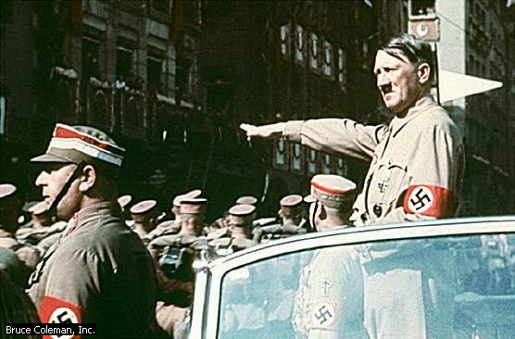
Hitler becomes chancellor

Slide 12
Hitler’s New Power
What did Hitler & the Nazis do?
Began to rebuild the military
Opened factories to build weapons
Put unemployed people to work building a superior highway system
The economy improved, but the people lost many of their civil rights…

Slide 13
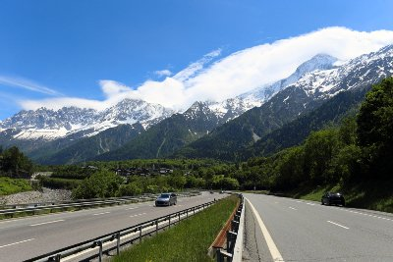
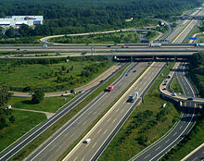
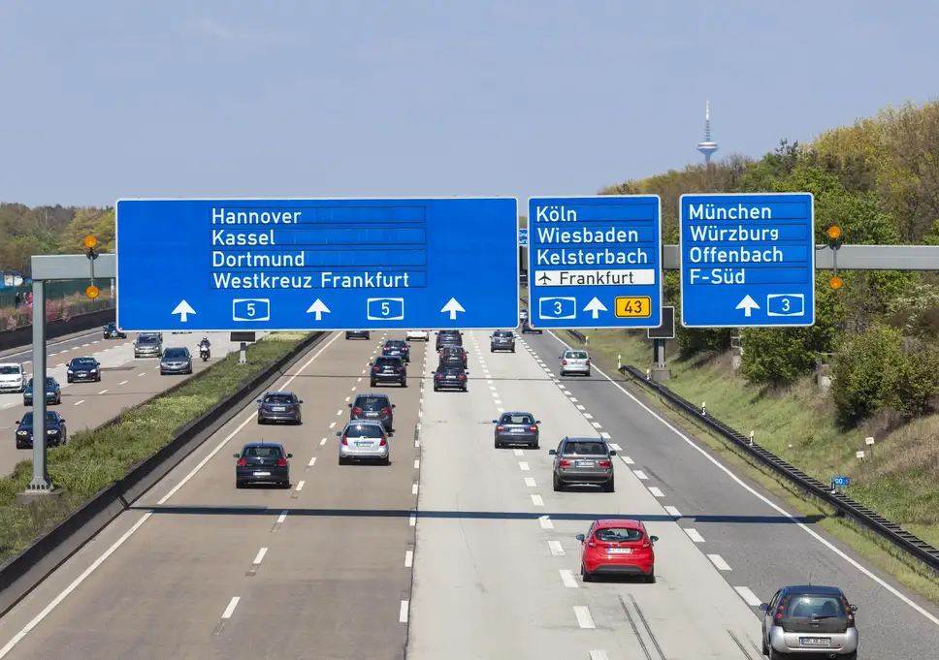

Slide 14
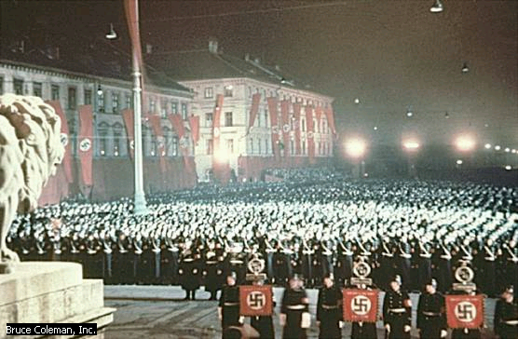

Slide 16
Hitler’s Actions
Germans who spoke against the Nazis were imprisoned or murdered.
Hitler’s military strength grew, and he began to make plans to go to war.
In 1936, he sent troops into former German territories that were lost in WWI.
By 1938, German troops controlled Austria & Czechoslovakia.

Slide 17
Europe Reacts
Other countries protested, but did nothing to stop Hitler.
In 1939, Germany invaded Poland.
France & Great Britain decided something had to be done and declared war on Germany.
World War II had begun…

Slide 18
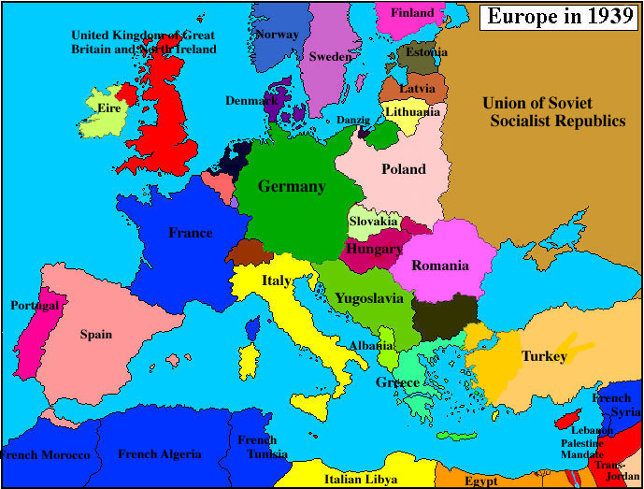

Slide 19
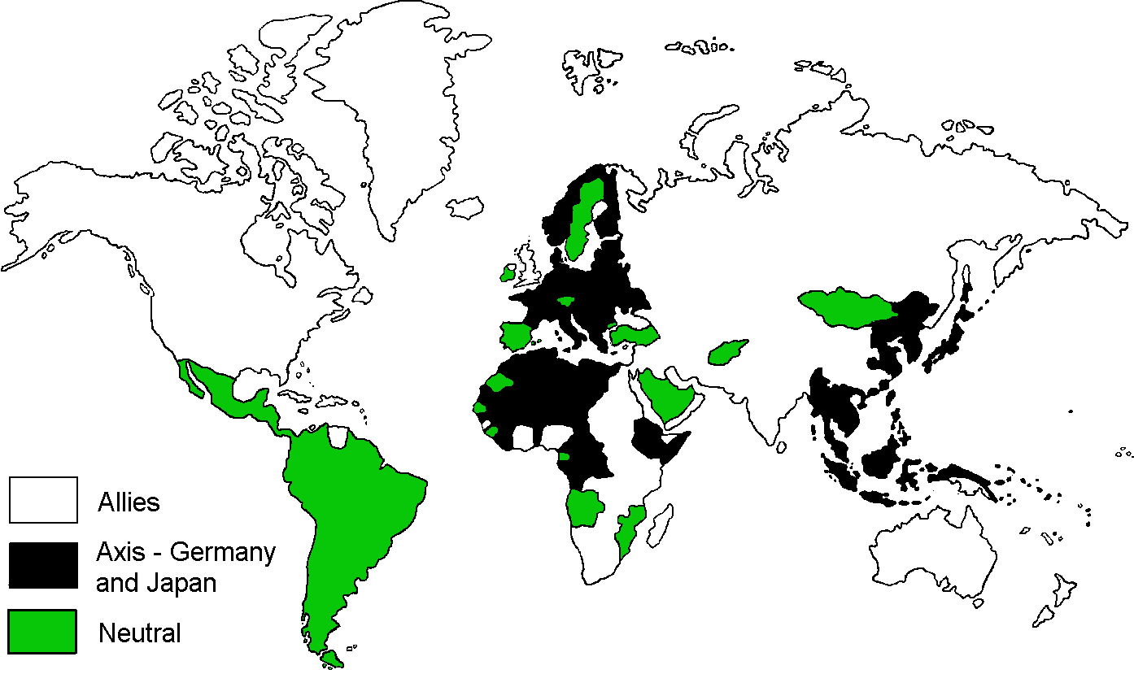

Slide 20
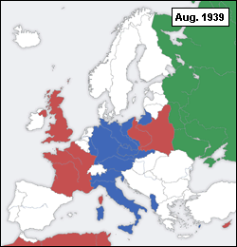
WW II Europe
Red countries are Allied or Allied-controlled.
Blue is Axis or Axis controlled countries.
The Soviet Union is colored green (prior to joining the Allies in 1941).

